Slide 1
The Ode
SEMESTER TWO
INTRODUCTION TO ENGLISH LITERATURE SIUAIEL21
DR. LAKSHMI MUTHUKUMAR,
HEAD, DEPT. OF ENGLISH

Slide 2
DEFINITION
A LONG LYRIC POEM THAT IS SERIOUS IN SUBJECT AND TREATMENT, ELEVATED IN STYLE AND ELABORATE IN ITS STANZAIC STRUCTURE.

Slide 3
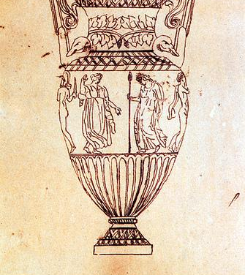
THE STRUCTURE OF THE ODE
The ode has an elaborate structure involving three parts known as the strophe, antistrophe, and epode. Originally, Greek odes were set to music.

Slide 4
ETYMOLOGICAL ORIGIN
The word ode comes originally from the Greek word ᾠδή (ōidē), meaning “song.” The definition of THE ode has thus clearly changed over time, as now it is often used colloquially to refer to any praise or glorification of an individual or thing.

Slide 5
TYPES OF ODES
The Pindaric
The Horatian
The Irregular

Slide 6
THE REGULAR OR THE PINDARIC ODE
STROPHE: RIGHT TO LEFT
ANTISTROPHE: LEFT TO RIGHT
EPODE: DANCERS STOOD STILL
E.g. Collins’ Ode to Evening
NAMED AFTER THE ANCIENT GREEK POET PINDAR

Slide 7
THE HORATIAN ODE
SHORTER STANZAS (ONLY FOUR LINES EACH)
SIMILAR ARRANGEMENT WITH RESPECT TO METER AND RHYME
THOUGHT CONVEYED IN A STRAIGHTFORWARD MANNER
SOBER STYLE WITHOUT THE PASSIONATE MANNER OF THE PINDARIC ODE
e.g.Keats’ Ode to Autumn
ALSO CALLED THE LESBIAN ODE

Slide 8
THE IRREGULAR ODE
INTRODUCED IN 1656 BY ABRAHAM COWLEY WHO IMITATED THE PINDARIC STYLE AND MATTER BUT DISREGARDED THE RECURRENT STANZAIC PATTERN IN EACH STROPHIC TRIAD.
EACH STANZA OF THE IRREGULAR ODE HAS ITS OWN PATTERN OF VARYING LENGTHS.
e.g. Wordsworth’s Ode : Intimations of Immortality
ALSO CALLED THE COWLEYAN ODE

Slide 9
KEATS’ ODE ON A GRECIAN URN
John Keats’s “Ode on a Grecian Urn” is perhaps the most well-known ode ever written.
There is rhyme throughout, but it is not as strict as other rhyme forms.
Keats wrote this poem to glorify the virtues of classical Greek art; therefore, no other poetic form is as fitting as the ode, which is an example of classical Greek art itself.
AN EXAMPLE OF THE IRREGULAR ODE

Slide 10
THANK YOU AND ALL THE VERY BEST FOR YOUR EXAMS!

